Slide 1

Cocktail Recommendation System

Slide 2
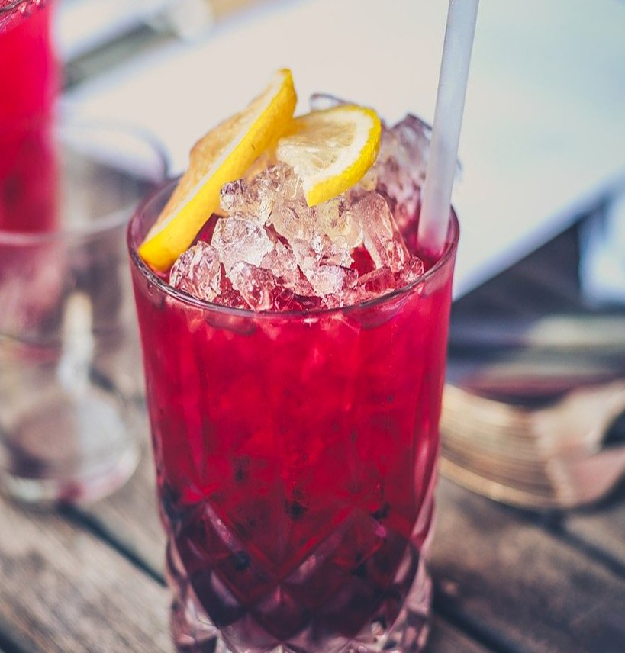
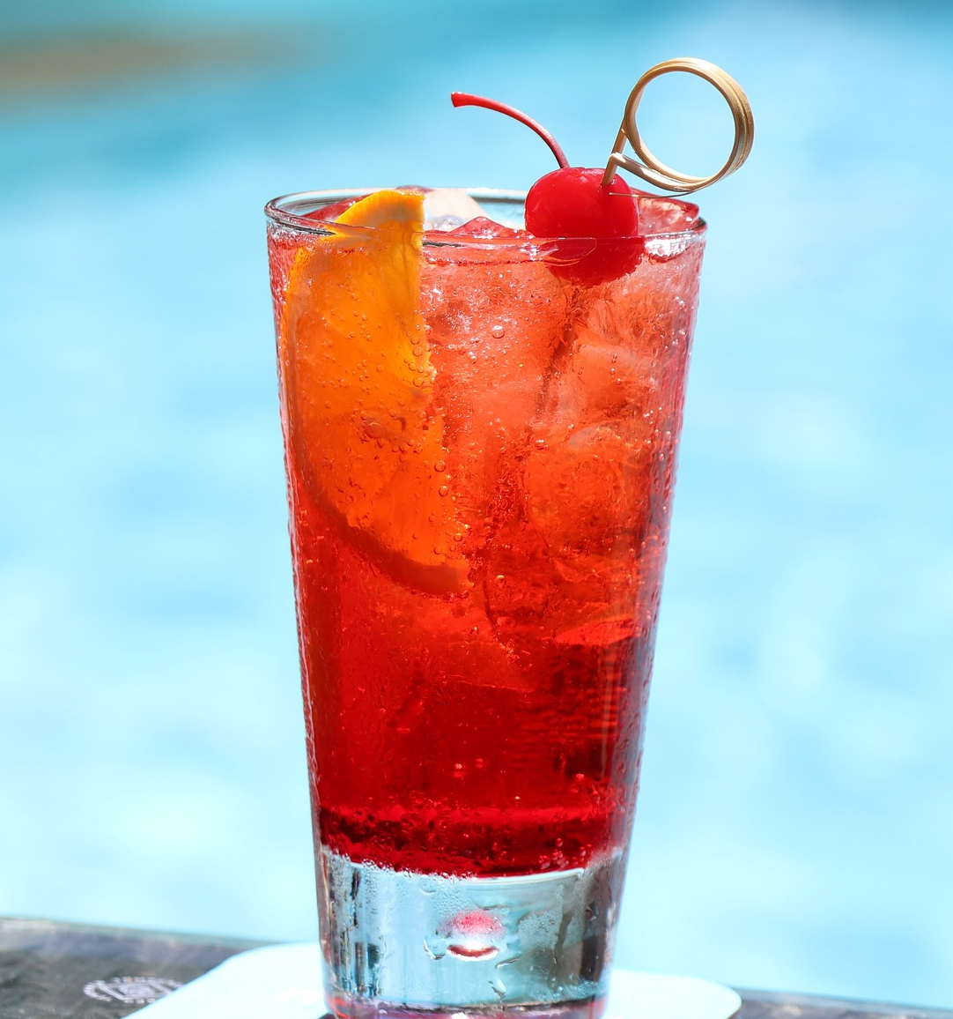
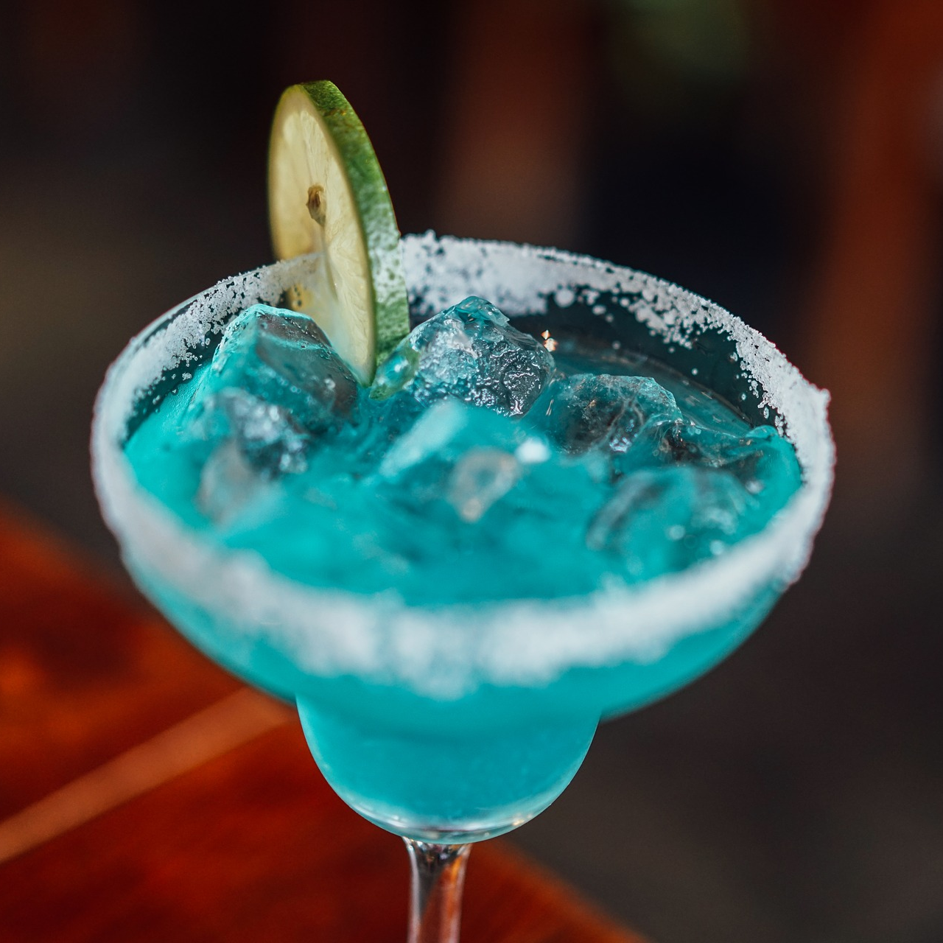
When you go to the bar always order the same drink?
We have an option for you!

Slide 3
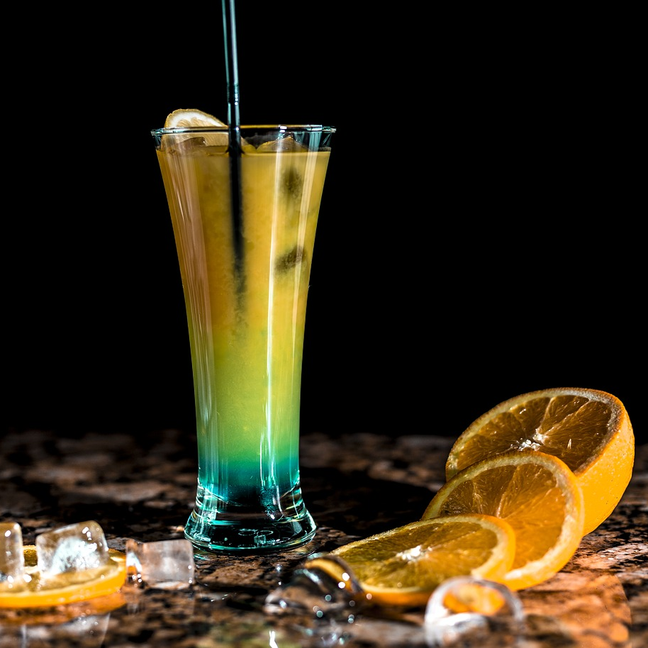
Business Problem
To build a recommendation system based on drink and cocktail recipes from around the world.

Slide 4
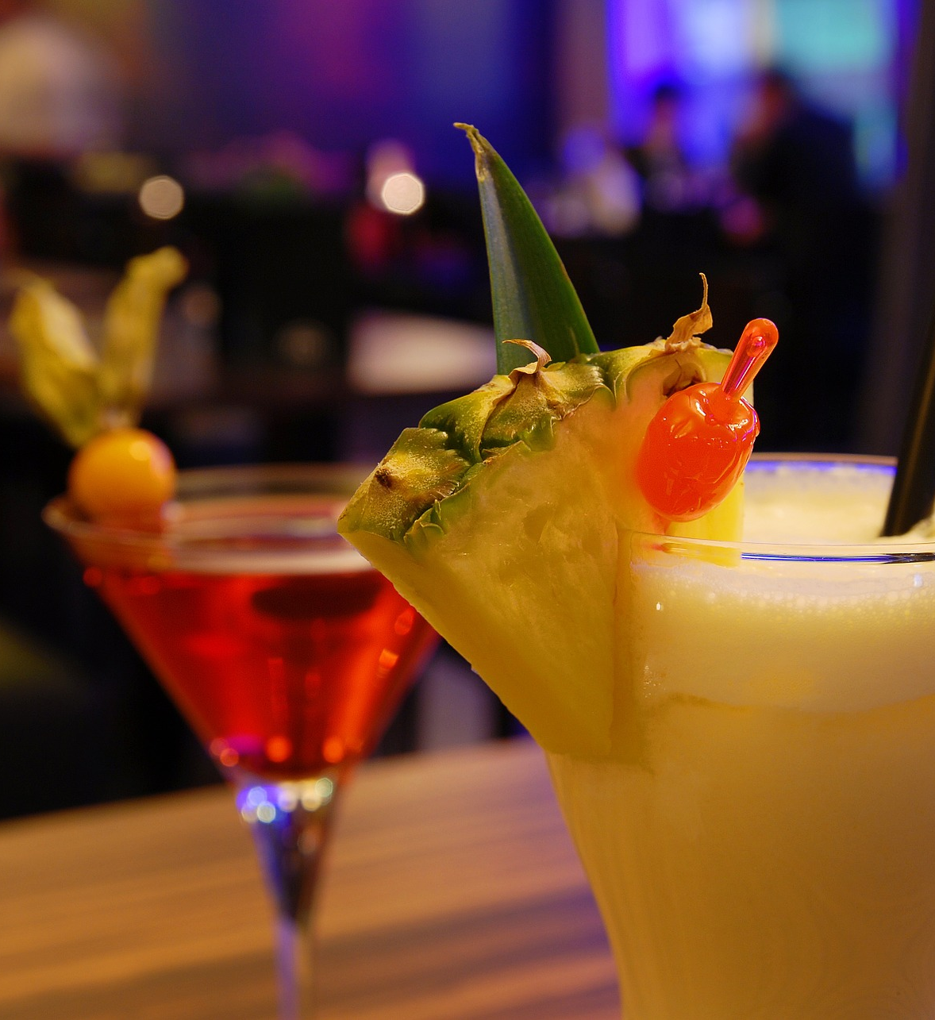
Machine Learning Problem
ONE OF THE CENTRAL AREAS OF RESEARCH IN ML
Recommendation systems are a very well studied area of Machine Learning, generally relying on unsupervised learning techniques or reinforcement learning
CLUSTERING RECOMMENDATION IS WELL STUDIED
For our specific problem, we implement two different clustering models to generate the predictions: K-Means and Mean-Shift

Slide 5
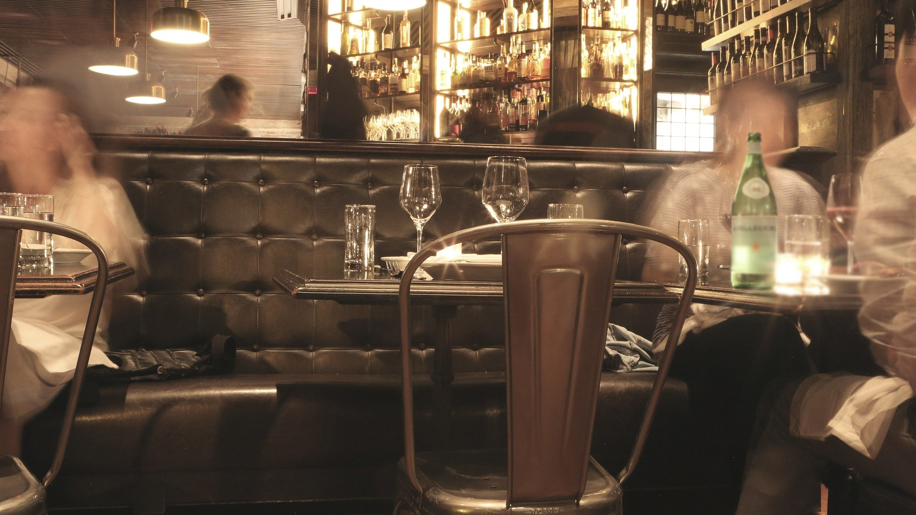



Data Ingestion and Feature Engineering
DATA SOURCES
We call TheCocktailDB API, the output is a JSON object with the information that we requested.
CLOUD STORAGE
We access the extracted data in Big Query, where we build a table that stores the info.
DATA PROCESSING
After our initial data load, we manipulate and transform the data in SQL as a follow p step to be able to use it.
The first thing we do is that we turn the cocktails into an occurrence matrix for ingredients, 0 if it does not occur in the cocktail, 1 if it does.

Slide 6
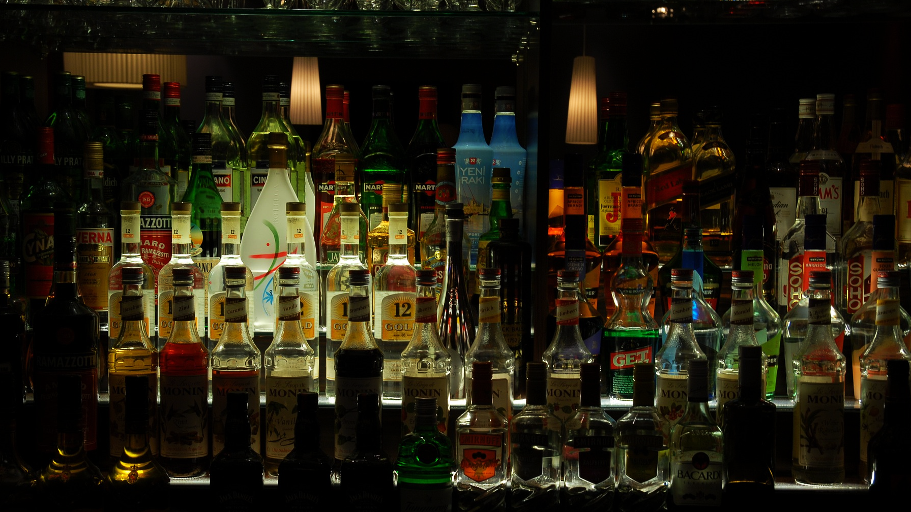
thank you

